Slide 1
DIGITAL LOGIC 数字逻辑
COLLEGE OF COMPUTER SCIENCES
LUXIAOCHUN 卢晓春

Slide 2
Instructional objective
After you finish this course, you should be able to master the following:
basic system of digital logic system
encoding,
Boolean algebra
combinational logic and sequential logic circuit design
The basic course of Computer Organization.

Slide 3
Course content
This course introduces the basics of digital circuit design and analysis, including
Number systems（数制系统）
Combinational logic（组合逻辑）
Flip flops（触发器）
Counters（计数器）
Registers（寄存器）
Sequential circuit analysis and design.（时序逻辑电路分析及设计）

Slide 4
About Course
Course book
Digital Fundamentals(Eleventh Edition)， by Thomas L. Floyd
Reference Book
Digital Logic Applications and Design, by John M.Yarbrough
Other books with the key words: digital logic.
Total mark
Attendance & homework: 20%
Quiz: 30% (10% × 3)
Final exam: 50%

Slide 5
Introductory Concepts
基本概念

Slide 6
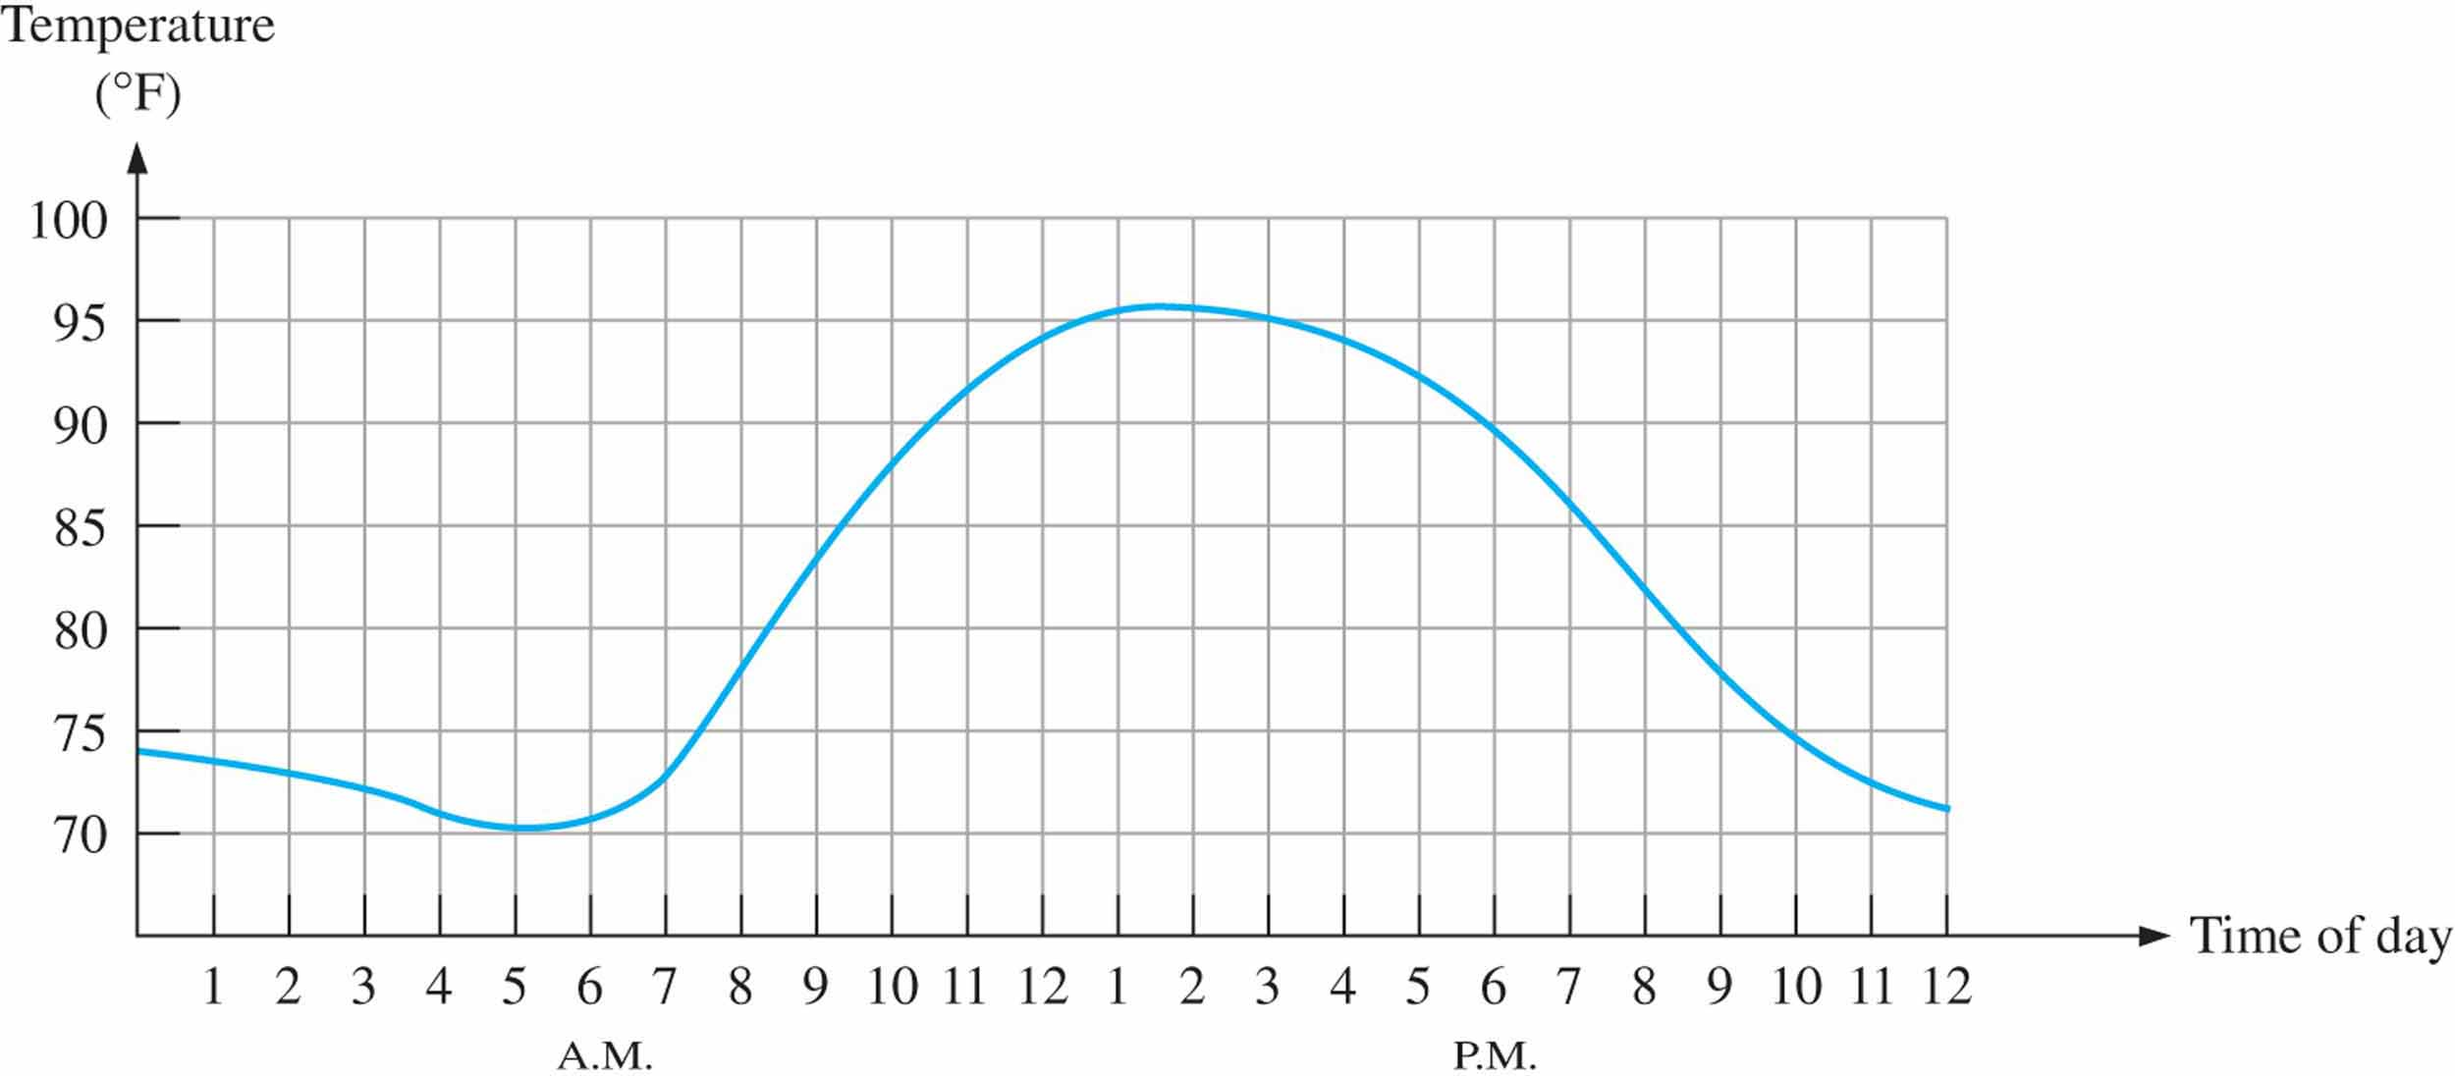
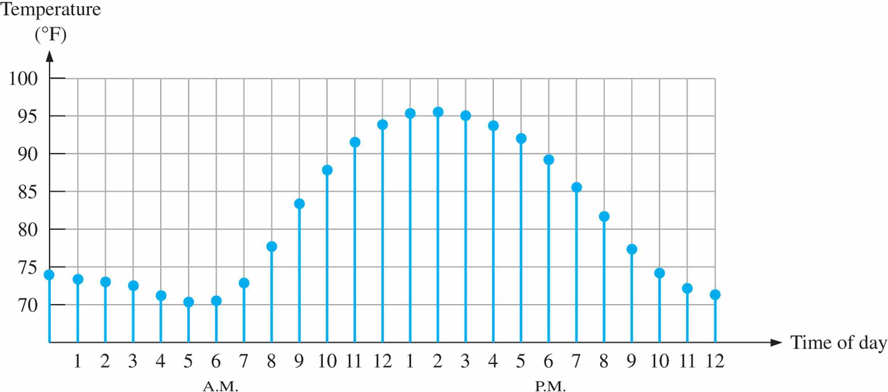
Digital and analog quantities （数字量与模拟量）
Figure 1.1 Graph of an analog quantity (temperature versus time)
Figure 1.2 Sampled-value representation (quantization) of the analog quantity in Figure 1–1
An analog quantity is one having continuous values
A digital quantity is one having a discrete set of values

Slide 7
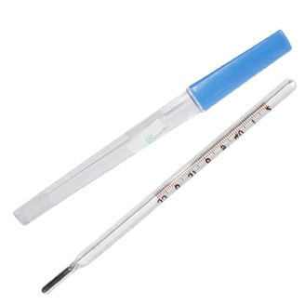
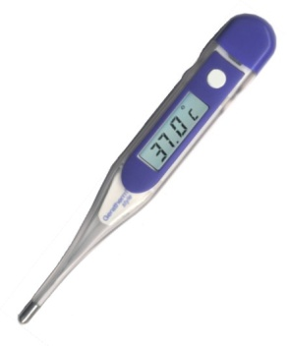
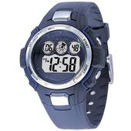
Digital and analog quantities
ANALOG
DIGITAL
Without breaks, smooth, no interruptions; a range of values forming a line or curve without gaps or discontinuities.
Broken down into pieces; opposite of continuous; a single part or point that can unambiguously be defined.

Slide 8
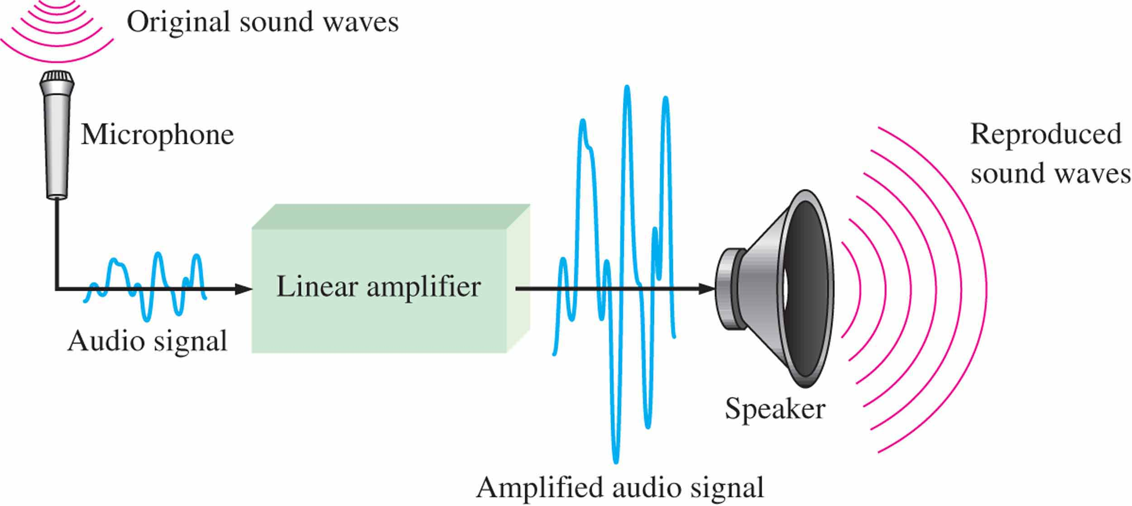
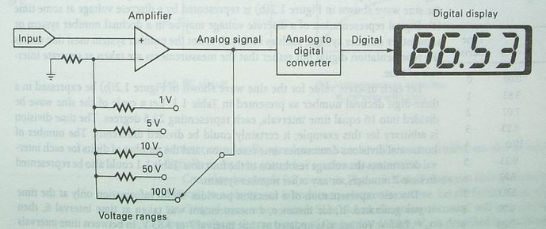
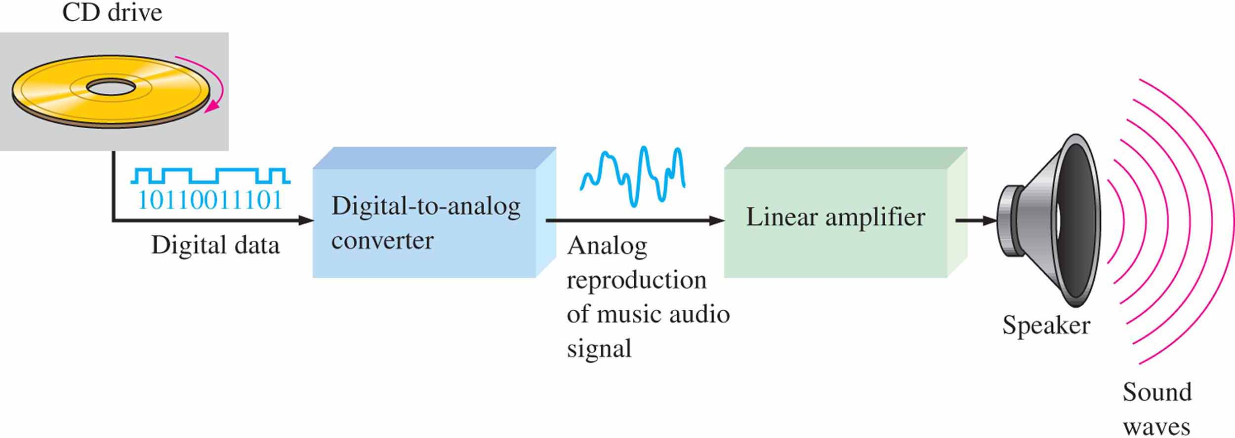
Digital and analog quantities

Slide 9
Digital and analog quantities
The Digital Advantage
Strong anti-interference ability, noiseless accumulation（抗干扰能力强，无噪声积累）
Easy to encrypt, store, process and transmit（易于加密、存储、处理和传输。
The Digital Systems：Systems that process discrete information

Slide 10
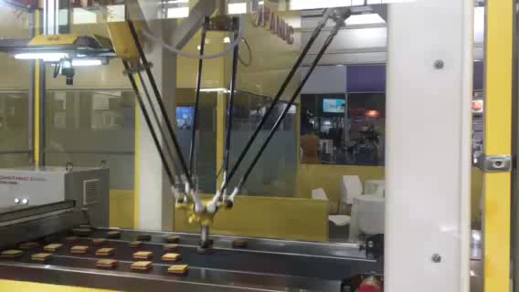
Mechatronics
Electronic controls
Electromechanical interface
Robotic unit

Slide 11
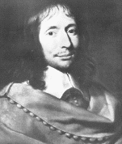
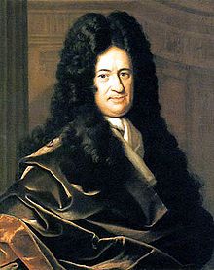
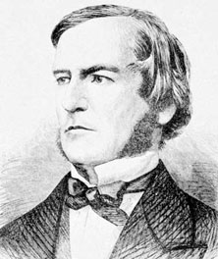
History of Digital System
Blaise Pascal
G.W. Leibniz
17th century
19th century
J.M. Jacquard
Charles Babbage
George Boole
communication,
entertainment,
technology,
our daily life
20th century
Nowadays
Intel： the first
microprocessor
11

Slide 12
Binary digits （二进制数）
Binary digits: each of the two digits in the binary system, 1 and 0, is called a bit（位，比特）.
Codes（码）：Groups of bits（combinations of 1s and 0s) are used to represent numbers, letters, symbols, instructions…
E.g. 10001001

Slide 13
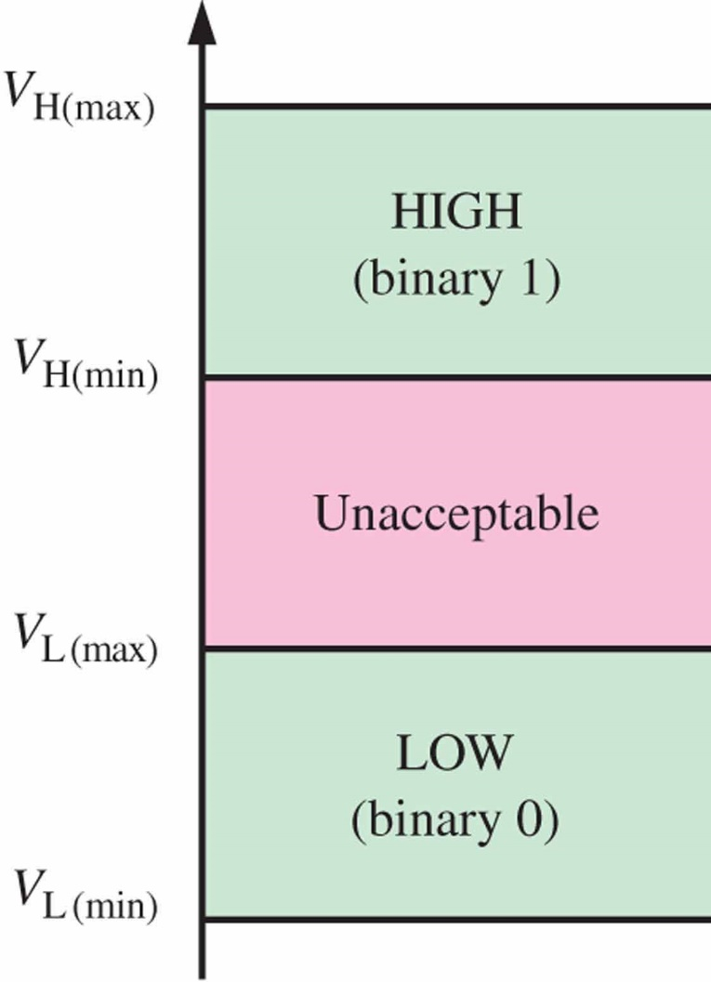
Logic Levels （逻辑电平）
Logic levels: the voltages used to represent a 1 and a 0
Specified range
No overlap.
Positive Logic（正逻辑）: HIGH = 1, LOW = 0
Negative Logic （负逻辑） : HIGH = 0, LOW = 1
E.g. CMOS：
HIGH: 2~3.3V LOW 0~0.8V

Slide 14
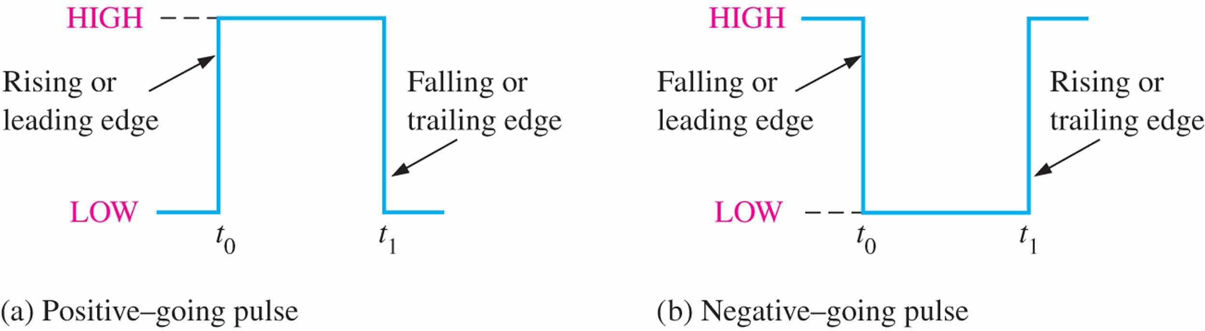
Digital waveforms （数字波形）
Digital waveforms: consists of voltage levels that are changing back and forth between the HIGH and LOW levels or states.
Pulse（脉冲）: A sudden change from one level to another, followed after a time, called the pulse width, by a sudden change back to the original level.

Slide 15
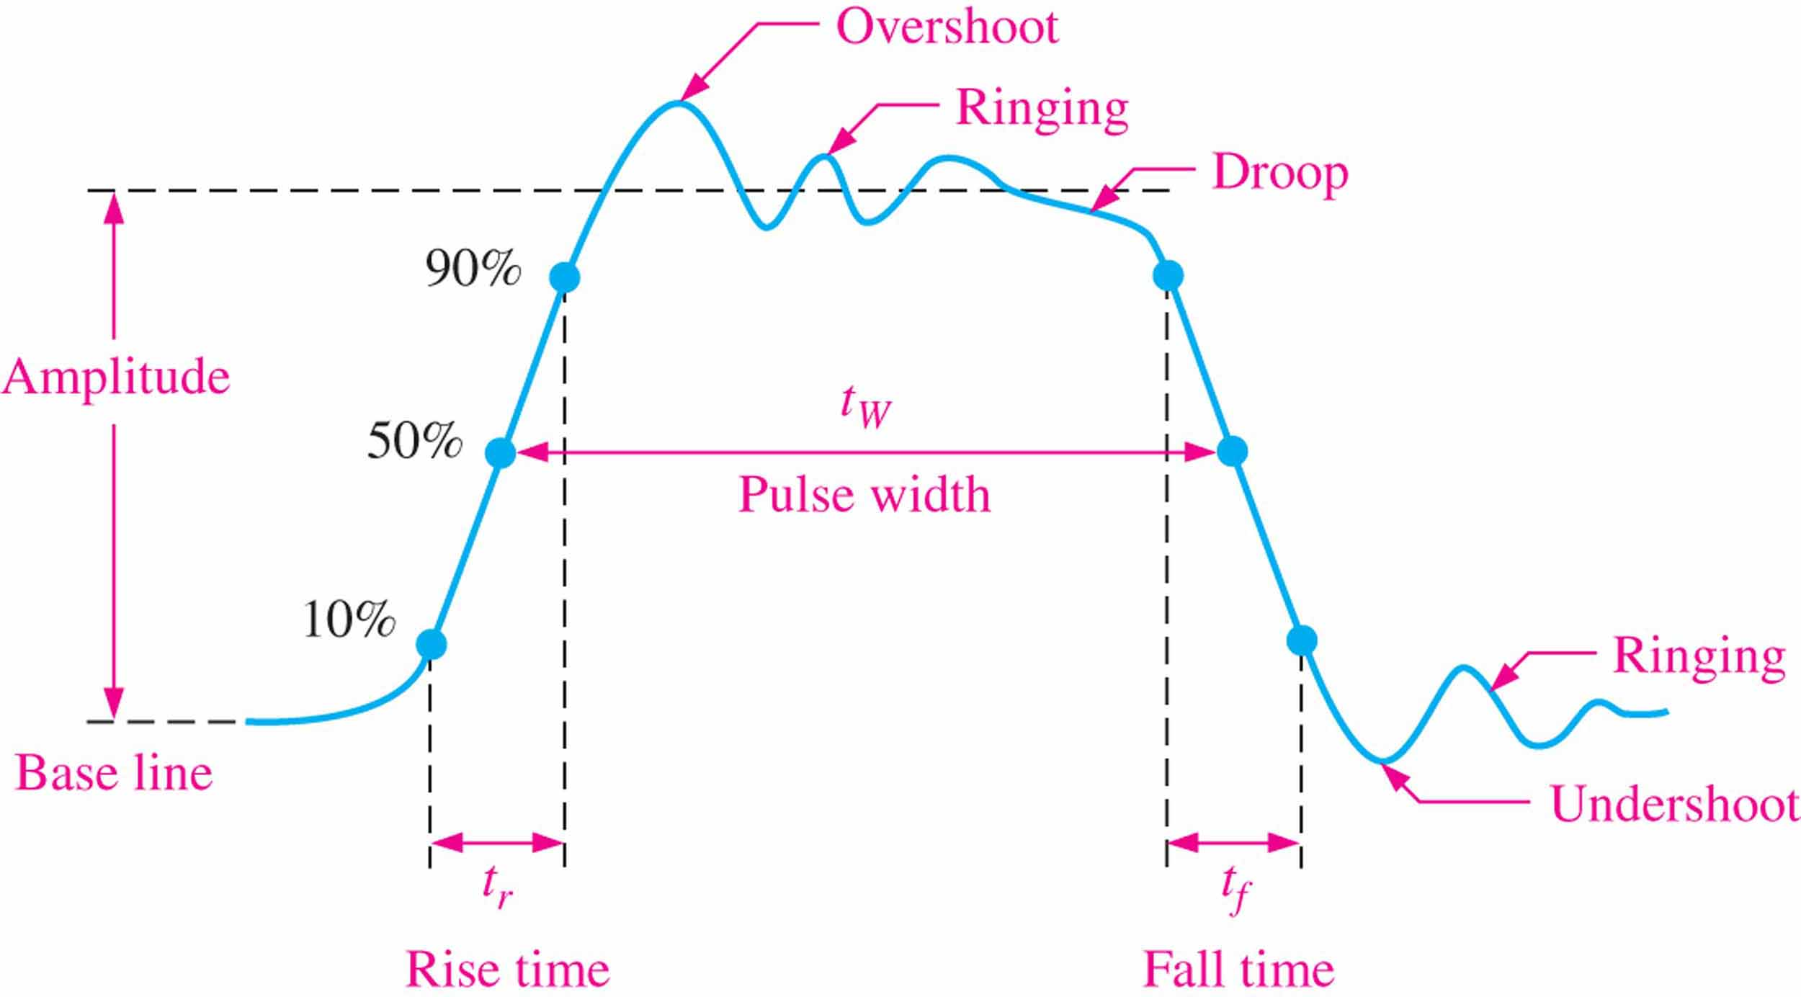
Digital waveforms -Nonideal pulse characteristics（非理想脉冲）
超调量
振荡
下降
幅度
脉冲宽度
基线
下调量
上升时间
下降时间

Slide 16
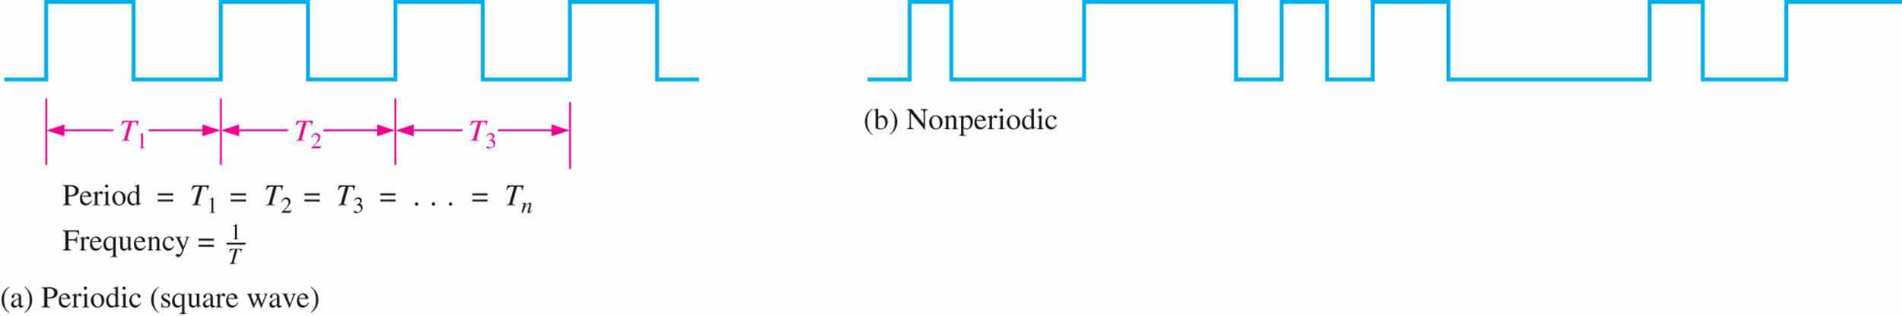


Digital waveforms --waveform characteristics（波形特性）
(a)Periodic
(b)Nonperiodic
$$Dute cycle=\left(\frac{t_{w}}{T}\right)100\%$$
$$f∗T=1$$
占空比

Slide 17
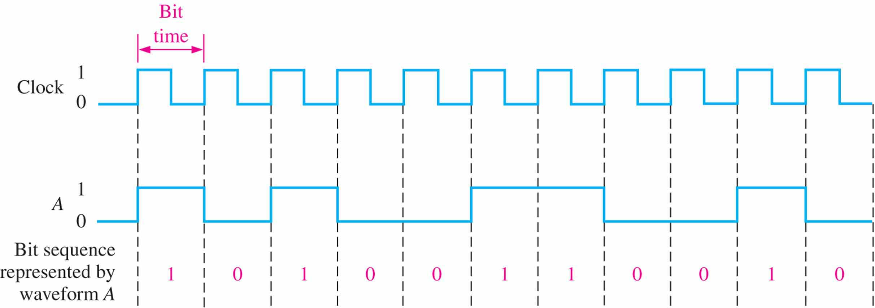
Digital waveforms --carries Binary information（携带二进制信息）
Clock（时钟）： the basic timing wave form. It’s a periodic waveform. ( T = bit time)
位时间

Slide 18
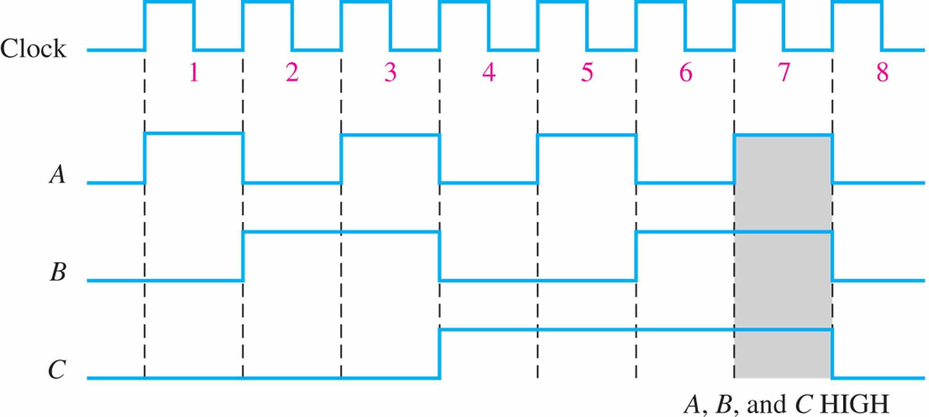
Digital wafeforms
Timing Diagram（时序图）：A graph of digital waveforms showing the actual time relationship of two or more waveforms and how each waveform changes in relation to the others.
An example of a timing diagram made up of four waveforms.

Slide 19
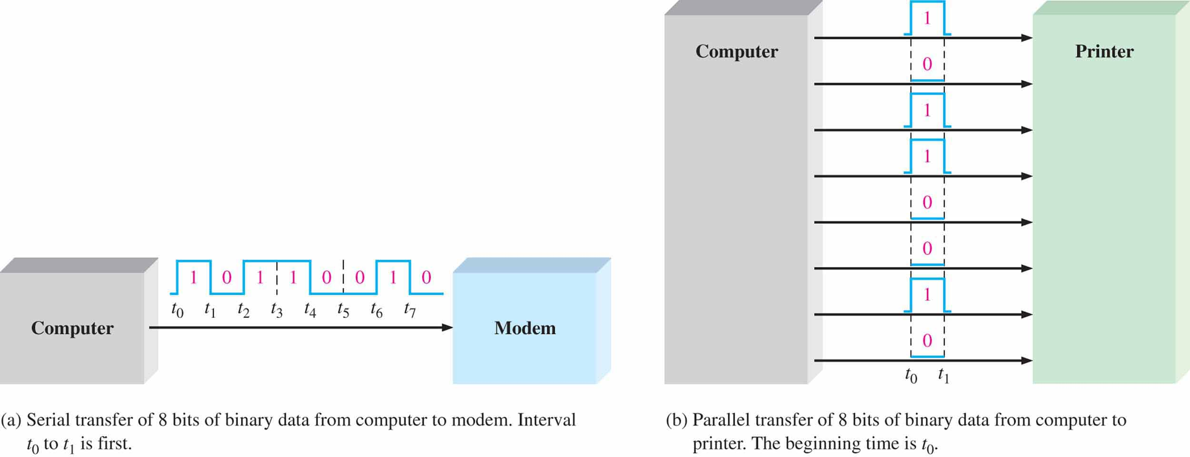
Data transfer （数据传送）
groups of bits
Data transfer: Binary data be transferred from one circuit(or system) to another.
serial transfer
Less line
Less time
parallel transfer

Slide 20
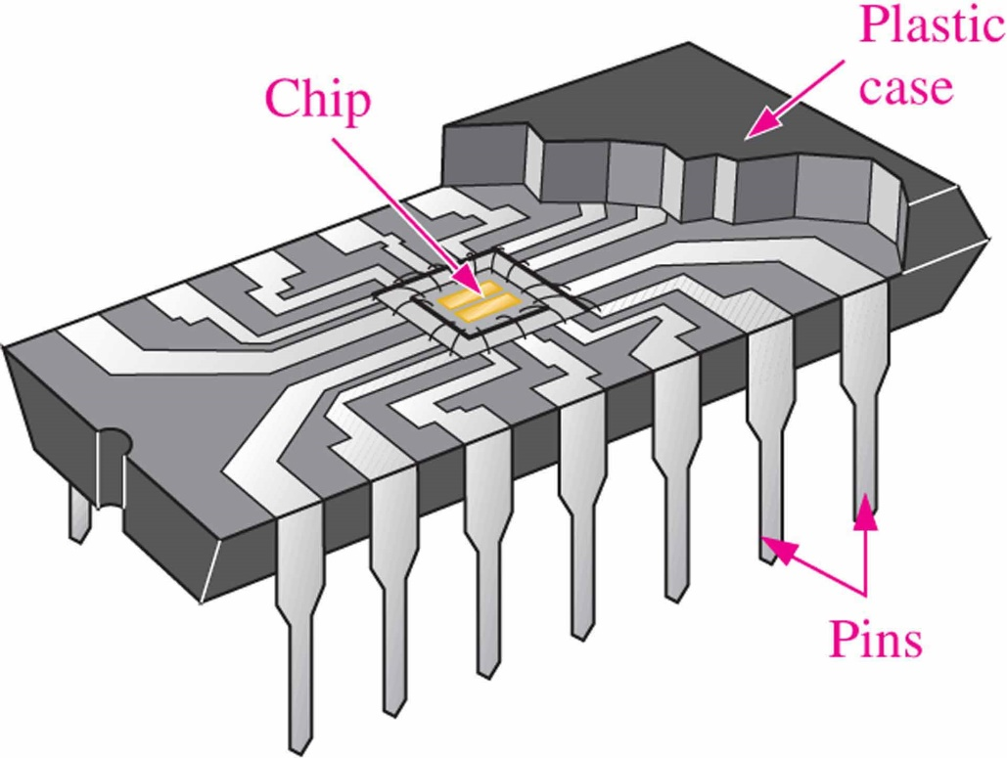
Fixed-Function Integrated Circuits （固定功能的集成电路）
IC is an electronic circuit that is constructed entirely on a single small chip of silicon.
塑料
外壳
芯片
引脚

Slide 21
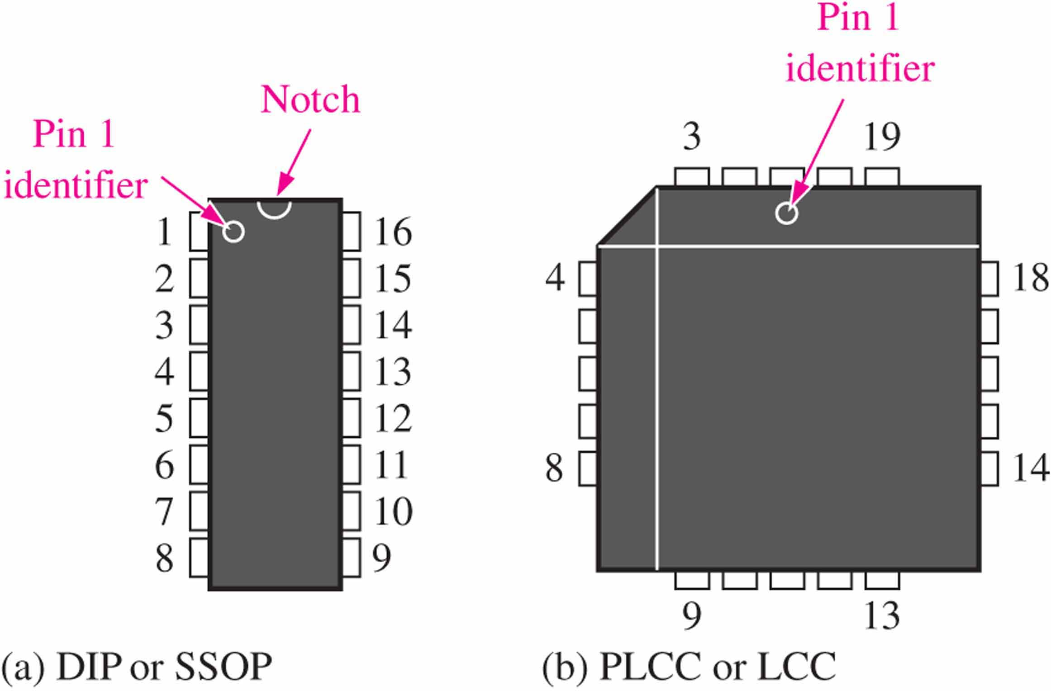
Pin Numbering （引脚编号）
Top views
顶视图

Slide 22
Complexity classifications （集成度分类）
SSI (Small-scale integration)： 1-10equivalent gate circuits
MSI (Medium-scale integration)： 10-99
LSI (Large-scale integration)：100~10000
VLSI (Very large-scale integration) ： 10000~1000000
ULSI (Ultra large-scale integration) ：more than 100000.

Slide 23
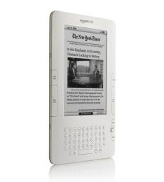
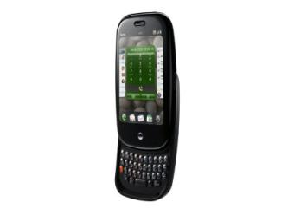
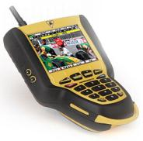
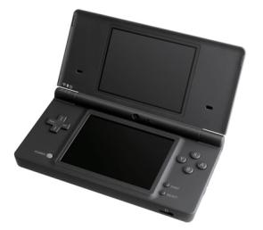
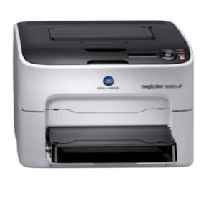
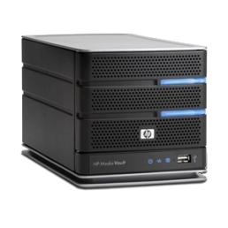
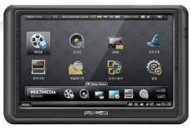
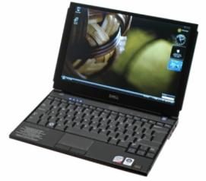
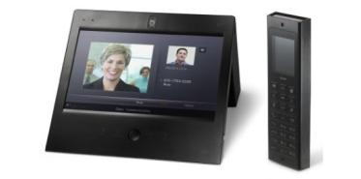
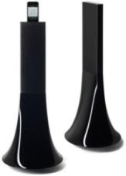
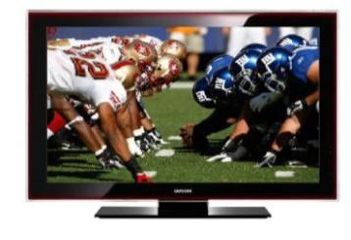
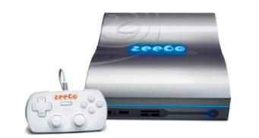
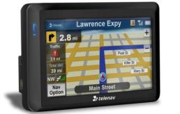
~4 Billion ARM Processors Each Year
Kangaroo TV
ARM926EJ-s
Freescale i.MX21 Processor
Amazon Kindle2 e-book reader
ARM Powered Freescale
Palm Pre
ARM Cortex A8
Texas Instruments OMAP3430
Nintendo DSi
ARM9 and ARM7 Processors
Konica Minolta Magicolor 1650EN Printer
ARM11 Processor
Zoran Corporation Quatro 4230 Processor
APSI M-480 PMP
ARM11 Processor
TI OMAP2530 Dual-Core CPU
iRiver Wave Home (Multimedia Communicator)
ARM Powered
HP mv5150 Media Vault Pro
ARM9 Processorr
Marvell Orion (88F5182-A2) Processor
Dell Latitude E4200 Notebook
ARM Cortex M3
Broadcom BCM5880
Zeebo Console
ARM11 Processor and ARM9 Processor
Qualcomm
TeleNav Shotgun
ARM926 Processor
SiRF Atlas III
Parrot : Zikmu Wireless speakers by Philppe Starck
ARM926 Processor
Samsung LN40A750 40-Inch 1080p DLNA LCD HDTV
ARM Powered

Slide 24
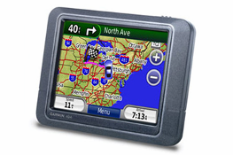
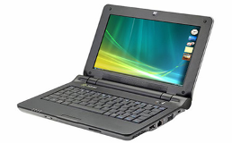
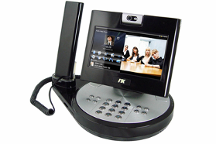
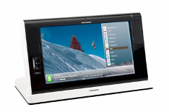
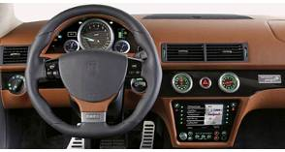
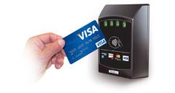
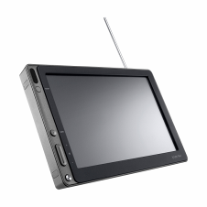
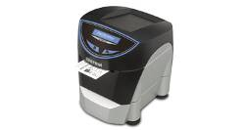
Everex Cloudbook UMPC
GCT Semiconductor – ARM9 Processor
Garmin Nuvi 205
ST Cartesio Processor - ARM926
Importek Apollo VoIP Video Phone
ARM9 + Marvell Xscale processor
Thomson WiFi Tablet
TI DaVinci TMS320DM6441 – ARM926EJ-S
Artega - Artega GT (Dual-Dashboard Display)
Fujitsu MB86R01 "Jade" graphics controller
ARM926EJ-s + Jazelle Java Acceleration Technology
VivoPay – Vivo Kiosk
ARM Powered
iRiver NV Life PMP
Magic Eyes - ARM926EJ +
ARM946E
Custom Engineering - TK300II Desktop Ticket Printer
ARM Processor (266MHz)

Slide 25
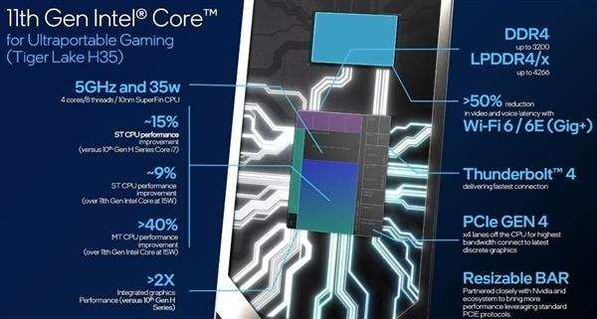
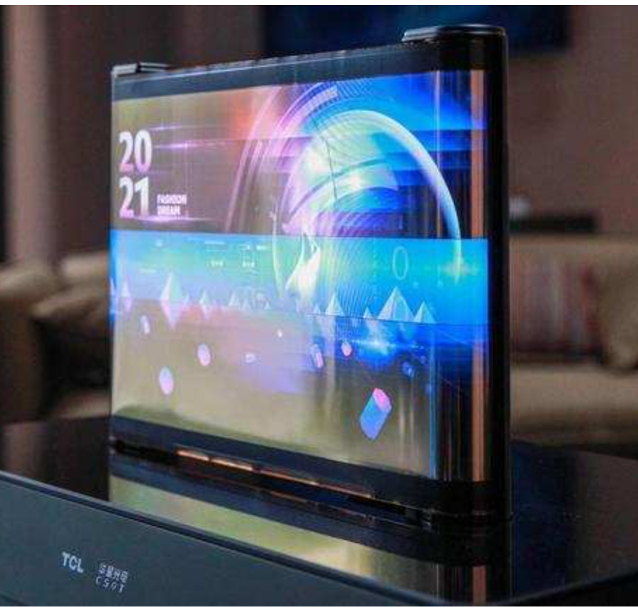
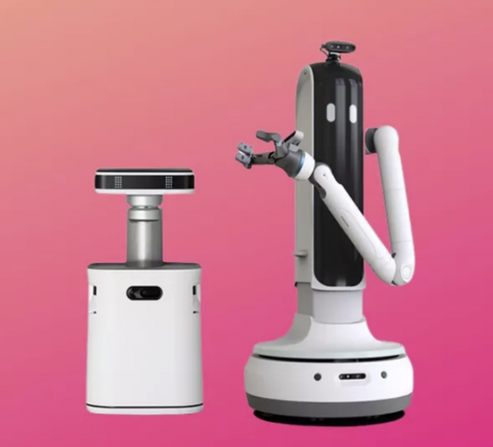
CES-2021 (International Consumer Electronics Show)

